Slide 1
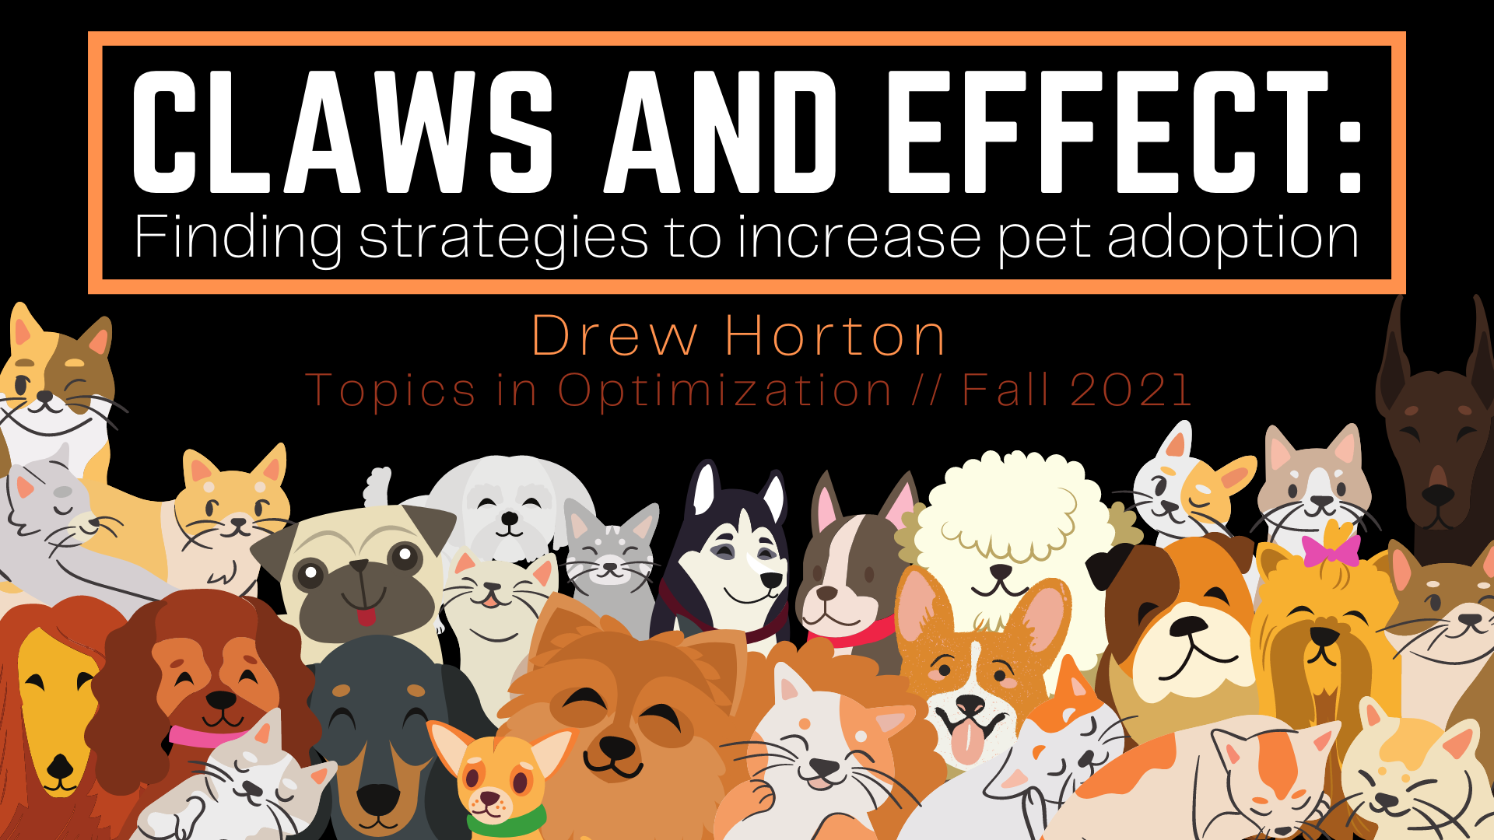

Slide 2

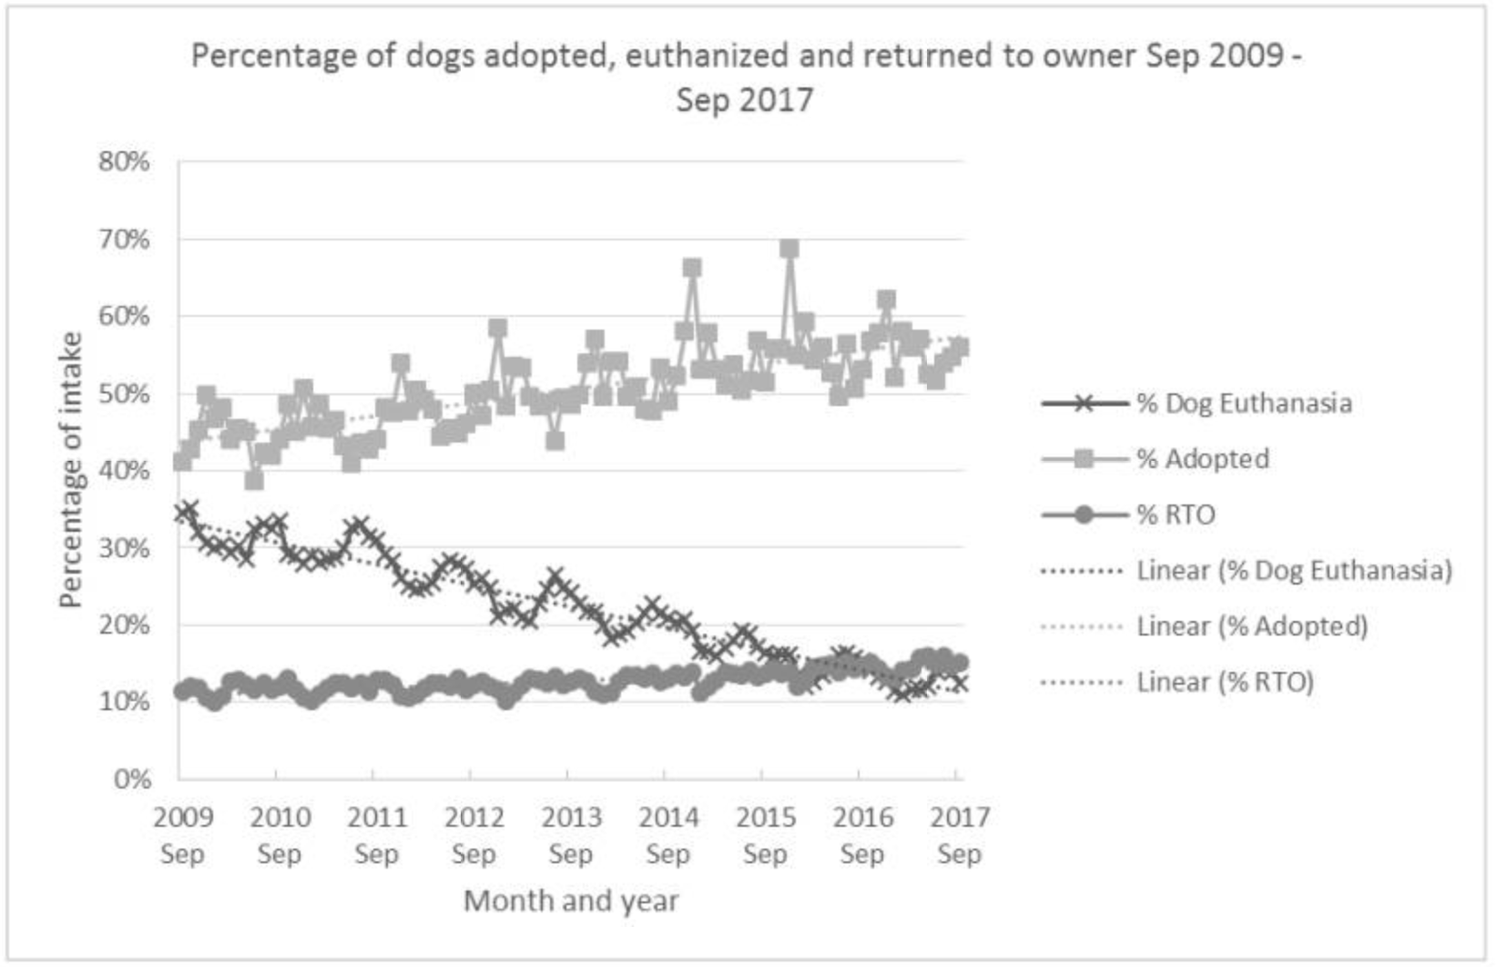
Background
Around 6.3 million pets enter animal shelters nationwide every year.
Approximately 920,000 of those animals are euthanized
Number has declined from 2.6 million in 2011.
Decline can be partially explained by an increase in the percentage of animals adopted.

Slide 3

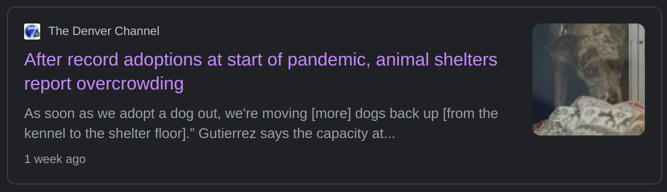
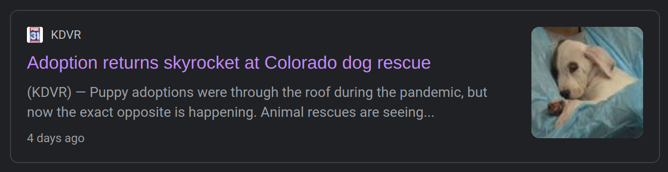
Motivation
pet adoption was booming during the early pandemic but has since slowed as people returned to work
some shelters have seen an increase of pets relinquished by the owners

Slide 4

Idea
Transferring pets between shelters/rescues is a strategy that is commonly used in animal facilities to help increase adoption rates.
According to Pet Animal Cares Facility Act(PACFA) Program, in 2019:
2983 adult dogs and 1229 juvenile dogs were transferred between Colorado animal rescues/shelters.
14154 adult dogs and 16138 juvenile dogs were transferred into Colorado shelters from out of state.
GOAL: demonstrate how circuit walks can be used to strengthen how shelters transfer pets amongst themselves

Slide 5







Data
The Pet Animal Care Facilities Act (PACFA) Program
a licensing and inspection program
dedicated to protecting the health and well-being of pet animals in facilities throughout Colorado.
collects the animal shelter and rescue data for Colorado
Data
yearly, 2015-2020
individual shelter level data for all of CO
all animal types
numerical data such as # of dogs relinquished by owner, # stray cats, # euthanized, #adopted

Slide 6
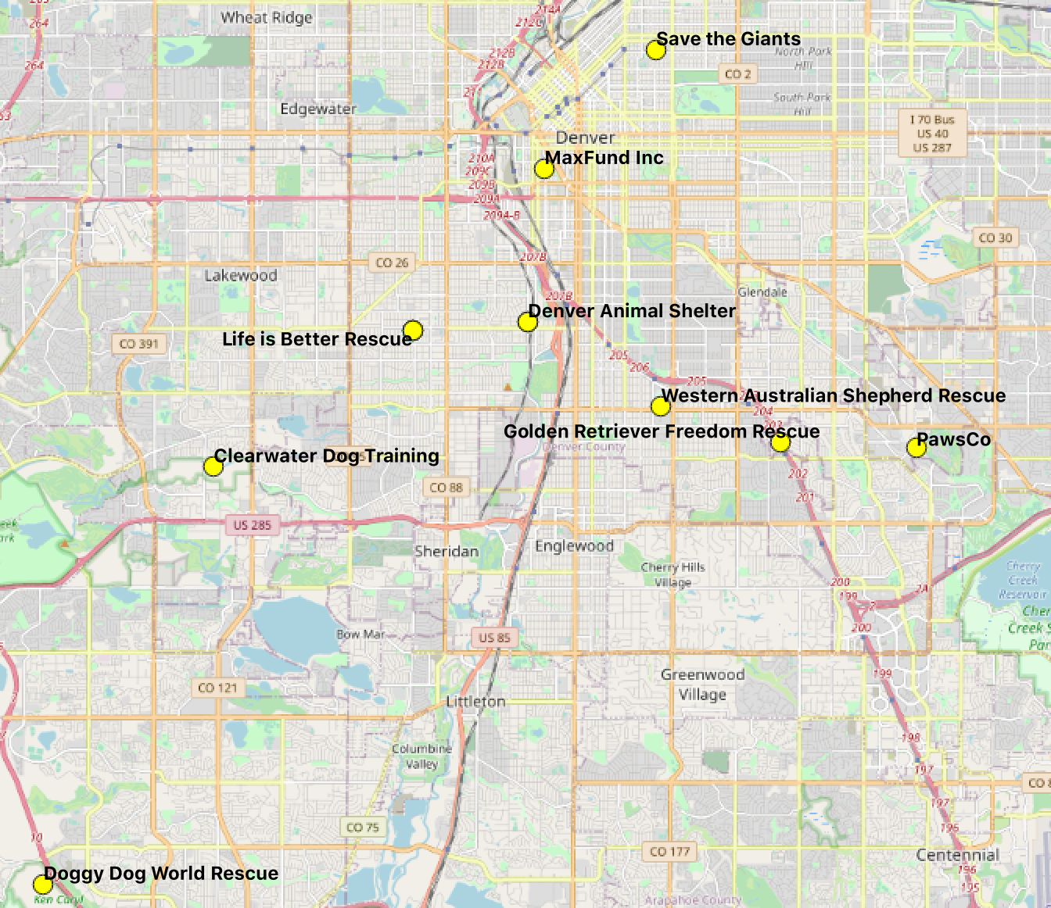
Assumptions/Simplifications
We will only look at dogs
2 nodes
juvenile and adult
701 puppies, 5347 adults
We will only look at the 13 shelters/rescues in the Denver area that handle dog adoption
Some of these shelters operate as separate entities but run out of the same building
We will treat them as separate facilities
13 Clusters
We will not differentiate between facilities that specialize in types of dogs (such as rescues that specialize in German Shepards)
We will assume the capacity for each shelter is the largest number of dogs that shelter has seen in any year
Also Friends of Retired Greyhounds & Saving Dobermankind Animal Rescue
Also Front Range German Shepherd Rescue
Also Dumb Friends League

Slide 7

Current State
Current state is an "imagined start state of 2021"
used data from 2019
701 puppies, 5347 adults
Some shelters are empty because they didn’t have data from 2019
#1 #2 #3 #4 #5 #6 #7 #8 #9 #10 #11 #12 #13
0 220 61 0 14 25 106 228 18 12 17 0 0
0 4175 115 100 106 146 70 494 72 31 38 0 0
Puppies
Adult dogs

Slide 8
Ideal State
Constructed at adoption rate for each shelter
the number of dogs adopted in 2020 and divided this by the total number of dogs in the shelter that year(minus all that were returned to owner)
We begin by sending as many adult dogs as we can(fill to adult dog capacity) to the shelter with the highest demand, and then continued greedily.
Repeat with puppies
#1 #2 #3 #4 #5 #6 #7 #8 #9 #10 #11 #12 #13
48 0 6 0 108 39 199 34 3 6 228 30 0
74 50 111 86 380 215 261 86 49 27 4008 0 0
Puppies
Adult dogs

Slide 9
Results
108
134
18
12
228
0
Least demand
0
220
61
0
14
25
106
228
17
48
9
13
0
Most Demand
70
86
72
31
446
0
0
0
4175
115
100
106
146
494
38
111
110
#1 #2 #3 #4 #5 #6 #7 #8 #9 #10 #11 #12 #13
211
408
408
211
Step 1
48
94
94
Step 2
48
4
4
Step 3
Step 4
Adult dogs(5347) Puppies(701)
Step 5

Slide 10

The sign-compatible circuit walk
20 total steps
#13
211 puppies from shelter #2 to #11
94 puppies from shelter #8 to #5
48 puppies from shelter #3 to #1
4 adult dogs from shelter #3 to #5
408 adult dogs from shelter #8 to #11
3562 adult dogs from #2 to #11
4 adult dogs from #10 to #5
14 puppies from #9 to #6
6 puppies from #10 to #7
14 adult dogs from #4 to #6
74 adult dogs from #2 to #1
9 puppies from #2 to #7
30 puppies from #8 to #12
55 adult dogs from #2 to #6
23 adult dogs from #9 to #7
168 adult dogs from #2 to #7
1 puppy from #9 to #7
7 puppies from #3 to #7
70 puppies from #10 to #9
266 adults from #2 to #5
#5
#4,#7,#9
#8,#12
#2
#3
#6,#11
#10
#1

Slide 11
Policy Recommendations
This project provides a preliminary structure for a method to strengthen the way we transfer animals in and out of shelters, rescues, and foster homes.
encourage shelters to keep as much data as they can to help us learn more about adoption patterns
comfortable capacities of shelters
with information about breed we can look at transferring animals to areas with more specific demand

Slide 12
Some shortcomings
Start vertex is using old data, not accurate to current state
Ideal vertex leaves some shelters with 0 dogs and 0 puppies, this is most likely not actually “ideal”.
Some of the shelters likely only handle certain types of dogs, but we ignored this for simplicity.

Slide 13

Future Work
Create a integer program to help pick a better ideal state
Figure out a better way to pick circuits for the circuit walk
Extend analysis to nationwide
Some states have higher rates for euthanasia, so using this program to transfer pets out of high kill areas into high demand areas could save many pets.
Incorporate breeds of animals
Instead of looking at just adult dogs and puppies, we could look at different breeds.

Slide 14

References
Rowan A, Kartal T. Dog Population & Dog Sheltering Trends in the United States of America. Animals (Basel). 2018;8(5):68. Published 2018 Apr 28. doi:10.3390/ani8050068
Steffen Borgwardt, Charles Viss, Circuit walks in integral polyhedra, Discrete Optimization, 2020,100566, ISSN 1572-5286, https://doi.org/10.1016/j.disopt.2019.100566.
Data
https://ag.colorado.gov/ics/pet-animal-care-facilities-act-pacfa/animal-shelter-and-rescue-individual-statistics
Pet Statistics
https://www.aspca.org/helping-people-pets/shelter-intake-and-surrender/pet-statistics
https://www.nytimes.com/2019/09/03/upshot/why-euthanasia-rates-at-animal-shelters-have-plummeted.html

Slide 15
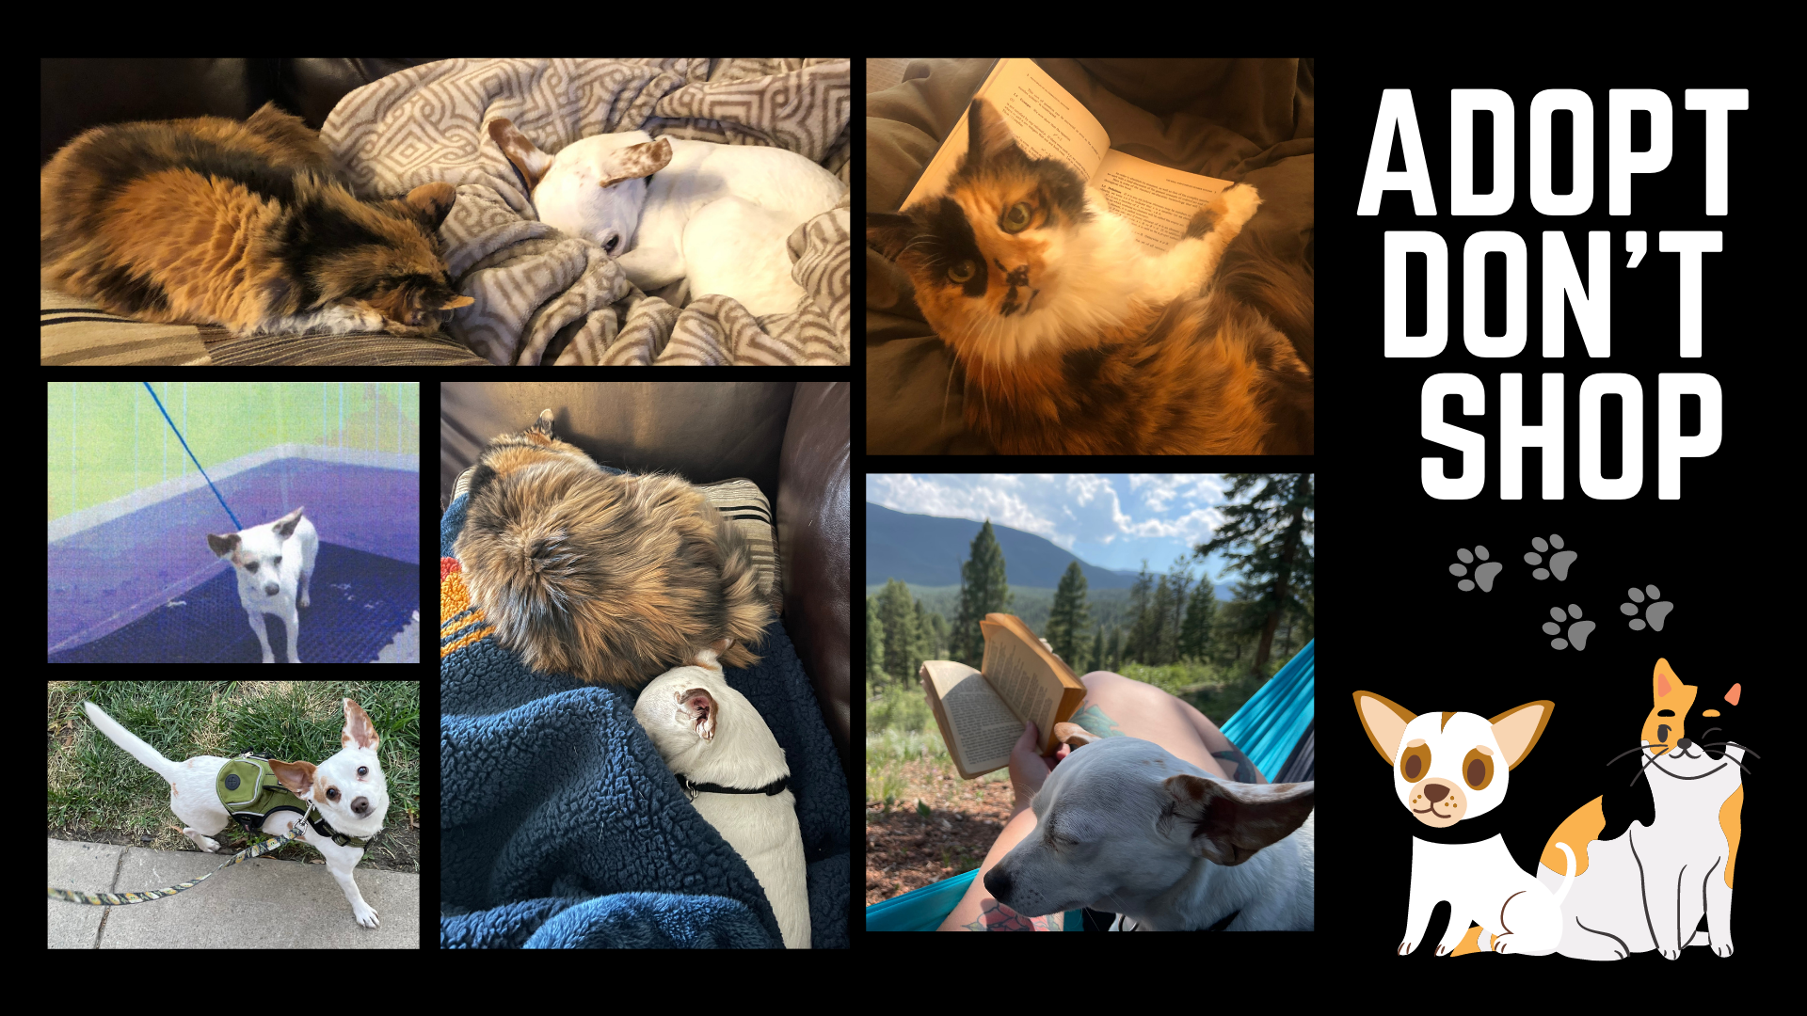
QUESTIONS?

